Slide 1
Python for Data Science
Week 1

Slide 2
Time allotment for today
30 Minute Recap:
What keeps you up at night?
Do you have Python ?
Can in pip install?
What are some of the basic variable types
Loops are ?
The outline of functions
Template for Code (not Jupyter notebooks)
120 Minutes - Lecture
Net Week Due:
Discussion Board “What functions are necessary/required”
Python script to import:
An image
Excel Sheet …

Slide 3
The Capstone Projects
You will be working on the capstone through the entire course:
Week 1: Team Assembly and Topic Identification
Week 2: Individual Goal
Week 3: Setup the SPRINT
Week 4: Build the Repository
Week 5-6: Pound the keys …

Slide 4
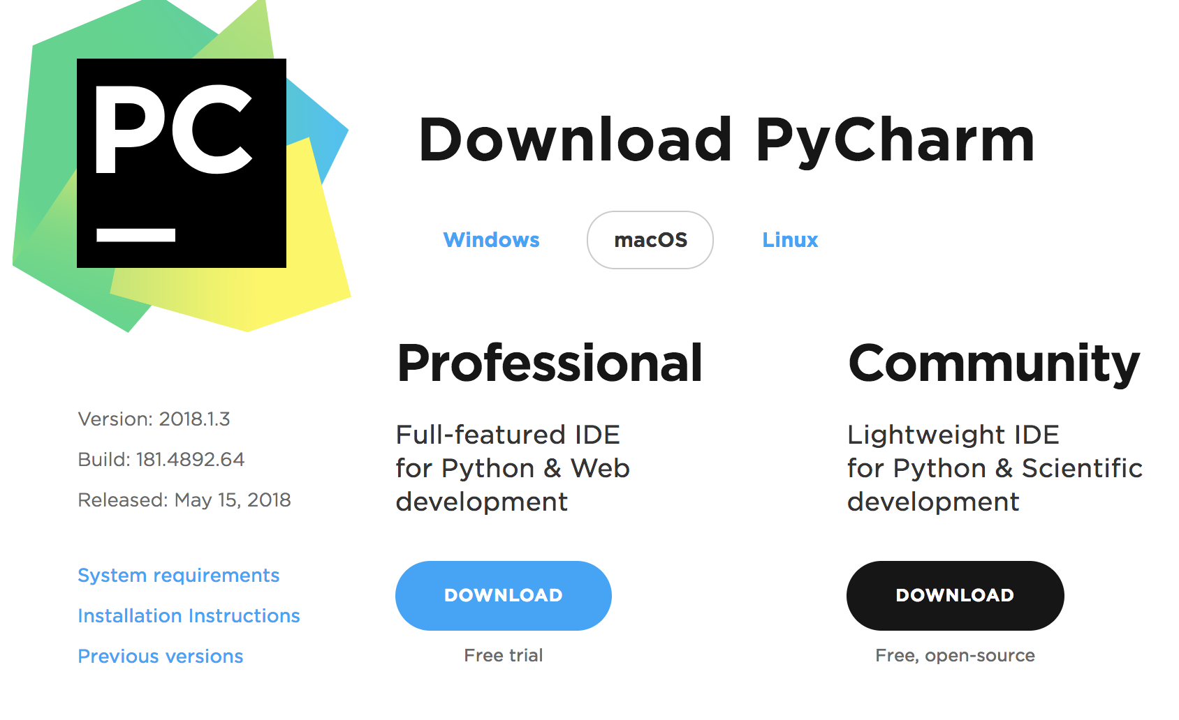
PyCharm is a Python specific IDE
The IDE is not a requirement, but a strong recommendation
https://www.jetbrains.com/pycharm/
Others Include:
Spyder
Anaconda

Slide 5
Functions are run someone else’s code
pip install – installs (attaches) add-on packages to the basic installation of python, note: packages remain installed until uninstalled
import – opens library of functions within a package, note: empty parenthesis lists libraries/packages available for opening in an Python session in upper-left window; note: libraries are closed when Python session is closed

Slide 6
Atomic data types are the "basics" for R-programming
Atomic Type | Python
character | String
real | float
integer | integer
logical | boolean
Notes:
Data types are assigned to each element in R, and this classification defines what type of operations can be performed on these elements. The most common data types in R are character, real, integer, complex, and logical. These are known as atomic types. There are different functions which can be used to query elements to learn about their data type. These include the typeof(), mode() and class() functions, which return the results shown in the table for elements of each atomic type.
A character is analogous to a string in other programming languages. It can be used for storing alphanumeric information such as letters, words, sentences and numbers. Numbers stored as characters cannot be added or together, they are treated as text. Generally, categorical information is stored as character elements in data objects known as factors. Examples of character elements include:
"hello"
"hello123"
"123"
Characters must be input into R surrounded by non-curly quotation marks.
A real is the type used to store real numbers, including any number on the number line. It is similar to a double in other programming languages, it stores numbers in double-precision, floating-point format. Continuous, numeric data is stored as real elements in R. Examples of real elements include:
3.14159
3.0
3
Real elements are input into R as above, without quotation marks.
An integer is the type used to store integers, which are real numbers without a fractional component. In R, integer elements can be used to represent ordinal data, or as a means to keep track of a count of something that will never have a fractional component. Examples of integer elements include:
3L
as.integer(3)
Because real elements are input as numbers in R, integer elements must be input in a different way. Following the integer by the letter L, or inputting it inside the function as.integer() tells R that the element is of type integer.
A complex is the type used to store complex numbers or numbers with an imaginary component. We will not use these in this class, but it is worthwhile to note that a lowercase letter i next to a number will result in the creation of a complex element. The lowercase letter i is a special symbol in math, representing the square root of negative one, and should not be used as the name of a variable, or next to a number as the name of a variable because of the risk that typos will lead to the creation of a complex element rather than the intended variable assignment. Examples of complex elements include:
0i
2 + 3i
0.4 – 1.3i
A logical is the type used to store either true or false. This type is used to store the result of a logic statement, such as 3 > 5, which is false. False translates to a zero and True translates to a one in R. True, False, T and F should not be used as variable names because of the risk that typos will lead to the creation of a logical element rather than the intended variable assignment. Examples of logical elements include:
F
T
FALSE
TRUE
Logical elements are input into R as above, without quotation marks.

Slide 7
List and Dictionaries
Lists are containers data objects.
You can store related values together in a list
Each item can be accessed using a list index
Index starts with 0
Length of a list can be obtained using len() function
A dictionary is an associative data structure that stores pairs of keys and values.
Values can be accessed using the associated keys

Slide 8
Loops are also indented for legibility
Python supports two looping constructs
for var in list: # possibly exit using break # possibly loop again using continue # do something with var
while statement: # do something while statement is true # possibly exit using break # possibly loop over using continue # do something to possible change statement value

Slide 9
Last Week Recap

Slide 10
Outline for Today’s Class
Getting Data into Python
Extracting data using pandas
CSV files
Excel files
Reading from databases
SQLite o MySQL into Pandas
SQL Alchemy and Flask
Reading and parsing from the web
Primary Data Sources
Images
Binary Files

Slide 11
Chicken vs Egg
Do I talk about data processing packages like Numpy and Pandas first, then how to get data into these structures
Or
Do I talk about how to get data into Python and then highlight the function of the these packages.

Slide 12
Chicken vs Egg
Do I talk about data processing packages like Numpy and Pandas first, then how to get data into these structures
Or
Do I talk about how to get data into Python and then highlight the function of the these packages.

Slide 13
Brief Introduction to Pandas/Numpy Next Week specific Lectures on Functions
1 . Pip install NumPy
2. Pip install pandas
NumPy – “NumPy is the fundamental package for scientific computing in Python. It is a Python library that provides a multidimensional array object, various derived objects (such as masked arrays and matrices), and an assortment of routines for fast operations on arrays, including mathematical, logical, shape manipulation, sorting, selecting, I/O, discrete Fourier transforms, basic linear algebra, basic statistical operations, random simulation and much more.”
Version: 0.18
Pandas – “pandas is a Python package providing fast, flexible, and expressive data structures designed to make working with “relational” or “labeled” data both easy and intuitive. It aims to be the fundamental high-level building block for doing practical, real world data analysis in Python. Additionally, it has the broader goal of becoming the most powerful and flexible open source data analysis / manipulation tool available in any language. It is already well on its way toward this goal.”
Version: 0.22
https://docs.scipy.org/doc/numpy-1.13.0/user/whatisnumpy.html

Slide 14
The NumPy Array

Slide 15
Pandas has two main data types: DataFrames and Series
DataFrames are similar to the DataFrames found in R, but series are an enumerated list. Series has significant functionality added compared to the base package
http://slidedeck.io/min2bro/WebScraping
Notes:
http://slidedeck.io/min2bro/WebScraping

Slide 16
What are common types of data formats?

Slide 17
The CSV is a common file format … Oldie by Goodie
Example on Whiteboard:
With open
With csv reader
With Pandas

Slide 18
Working with Excel
Reading, Writing, Formating vs Just extracting Data
Don’t forget if it’s in Excel already you can always make a csv from excel. This trick can solve several problems.

Slide 19
Data extraction from excel
import pandas as pd pd.read_excel()
pandas.read_excel(io, sheet_name=0, header=0, names=None, index_col=None, usecols=None, squeeze=False, dtype=None, engine=None, converters=None, true_values=None, false_values=None, skiprows=None, nrows=None, na_values=None, parse_dates=False, date_parser=None, thousands=None, comment=None, skipfooter=0, convert_float=True, **kwds)
http://pandas.pydata.org/pandas-docs/stable/generated/pandas.read_excel.html?highlight=read_excel

Slide 20
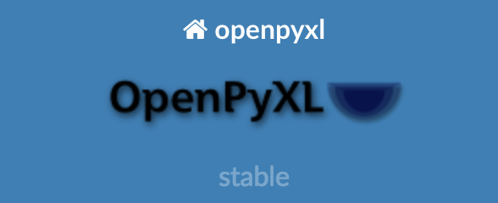
Packages for reading / writing
http://www.python-excel.org/

Slide 21
What is a nested data structures?
Nest data structures are used to organize data . . You already know one
Dictionaries

Slide 22
Html, xml and JSON are nested data structures to transfer web data
import requests
URL = 'https://api.coindesk.com/v1/bpi/currentprice/USD.json’
response = requests.get(URL)
response.json()

Slide 23
JSON maps onto python dictionaries
Import json
Outstring = json.dumps(Dictionary)
Dictionary = json.loads(Outstring)

Slide 24
RESTFul Architecture and Microservices
How does data flow around the internet
https://tutorialedge.net/general/what-is-a-rest-api/

Slide 25
Beautify Soup is a useful library for web-scraping and reading html

Slide 26
Databases with direct access via pandas
from sqlalchemy import create_engine
engine = create_engine("sqlite:///profession_and_age")
pd.read_sql_table('profession', engine)

Slide 27

https://www.sqlalchemy.org/

Slide 28
FLASK – Web based programing

Slide 29
Primary Data
Primary data is ..
Images
Financial Stock Traces

Slide 30
Images
Import cv2
Image = cv2.imread()

Slide 31
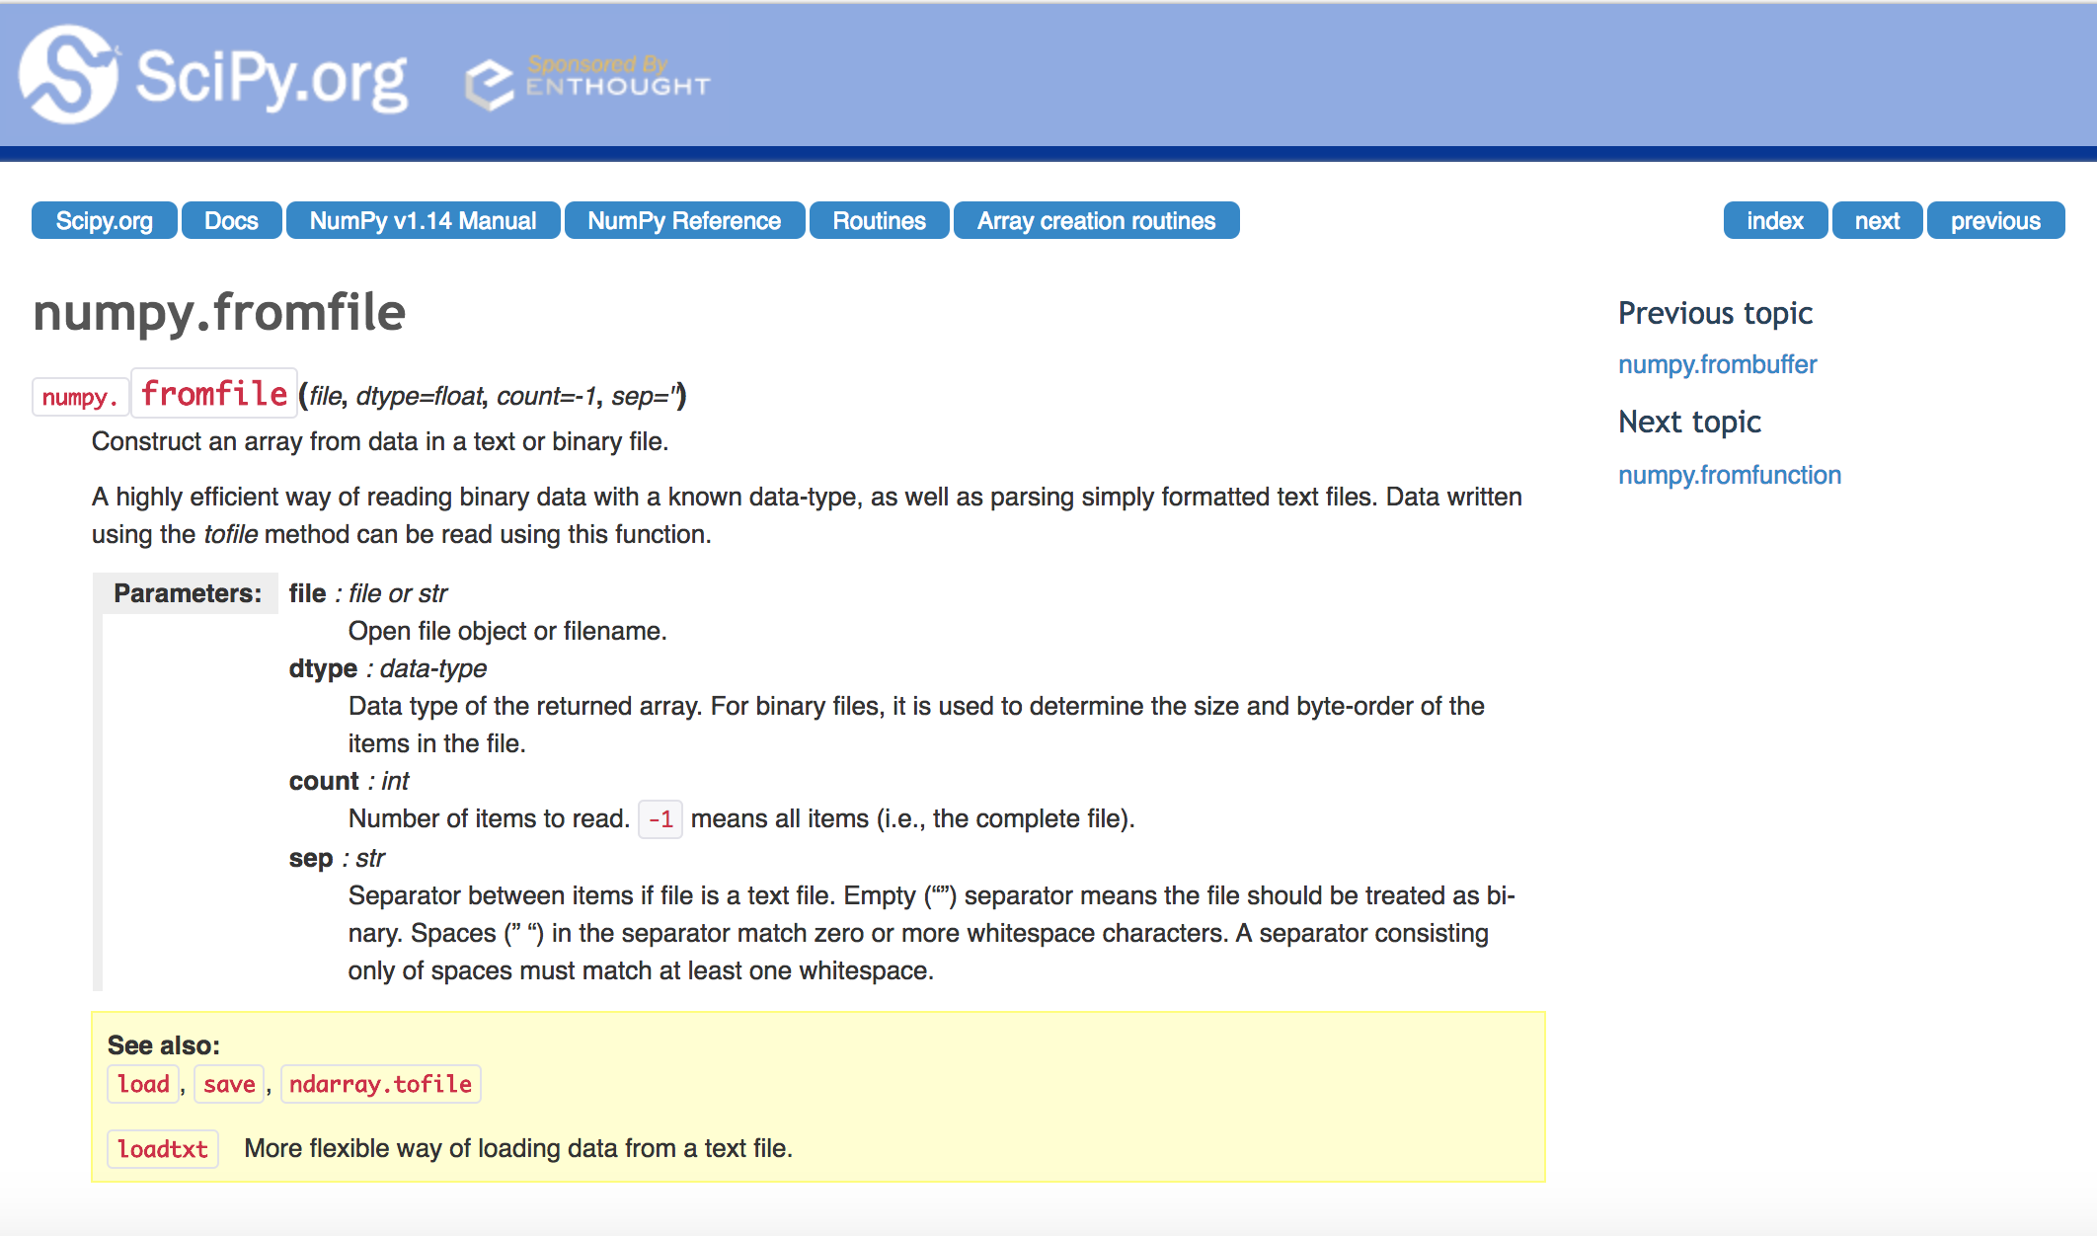
Stock Traces
Import numpy as np
trace = np.fromfile()

